Slide 1
MISSION HANDOVER
Objective
Provide a clean and practical handover of the scenarios, toolchain, deliverables, and reference flows.
JMeter Performance Testing
and Claims FPV2
Two workstreams:
1. JMeter execution, API sequencing, and performance report generation
2. Claims FPV2 reference flows and operational follow-up
Date
21 October 2026
Audience
Project / support / technical follow-up
EIKO / HANDOVER

Slide 2
01
PART 1
JMeter performance tests & performance report generation
Clear, concise, and ready to hand over.
EIKO / HANDOVER

Slide 3
PART 1 / CAMPAIGN
03
JMeter campaign overview
The same functional flow is reused for each load profile.
Warm-up
Wait
Scenario 1
Wait
Scenario 2
Wait
Scenario 3
Wait
Scenario 4
Wait
Scenario 5
Generate Token + 10 Purchase
2 min
1 user
Loop Count 50
Ramp-up 10 s
2 min
2 users
Loop Count 50
Ramp-up 10 s
2 min
4 users
Loop Count 50
Ramp-up 10 s
2 min
8 users
Loop Count 50
Ramp-up 10 s
2 min
12 users
Loop Count 50
Ramp-up 10 s
Key message
Scenario logic
Configuration note
• The campaign starts with a warm-up phase to heat the instance.
• There is a 2-minute waiting time between every scenario.
• Only the number of threads changes from one scenario to another.
• The API sequence remains identical.
• Proxy settings are externalized.
• Loop Count = 50 and Ramp-up = 10 seconds for all five scenarios.
Important: a dedicated 2-minute waiting period is inserted between each scenario.
EIKO / HANDOVER

Slide 4
PART 1 / EXECUTION
04
API sequence — sequential flow with conditional steps
One sequential scenario: Sale_BNS runs after the CPL sequence completes — or immediately if Purchase_Cpl fails.
THREAD EXECUTION
Generate Token
(Once Only)
Loop iteration
Purchase_Cpl
Purchase
OK?
NO / ERROR — skip CPL
IF #1
YES
Policy_Cpl
Generate PDF_Cpl
BNS — SEQUENTIAL CONTINUATION
YES
IF #2
Cancel_Cpl
Sale_BNS
Sale
OK?
Cancellation_BNS
The two purchase outcomes converge at Sale_BNS; only BNS cancellation depends on Sale_BNS success.
NO → skip cancellation
EIKO / HANDOVER

Slide 5
PART 1 / PERFORMANCE RECAP GENERATOR
05
Purpose, inputs, and outputs
Overview
Inputs
Generated output
This tool automatically generates performance dashboards from JMeter results.
It produces both an Excel file and a Word report.
Results are extracted from CSV scenario files, metrics are calculated, and the output is structured automatically.
IDP API-results-X-user.csv files generated by JMeter in RESULTS_FOLDER.
perf_template.docx placed in the DOC_TEMPLATE folder.
recap_scenarios.xlsx → aggregated metrics + scenario sheets
perf_result_output.docx → Word summary with execution dates and formatted tables
recap_scenarios.xlsx
SharePoint
recap file
JMeter CSV results
+ Word template
Performance Recap
Generator
python main.py
perf_result_output.docx
Confluence
reporting
Sources available in Confluence
• User guide page + attached sources: perfrecapgenerator.zip and perf_template.docx.
EIKO / HANDOVER

Slide 6
PART 1 / PERFORMANCE RECAP GENERATOR
06
Requirements, configuration, and execution
Requirements
.env configuration
Excel output details
Python 3.10+
Dependencies: xlsxwriter, python-dotenv
RESULTS_FOLDER=<directory containing JMeter CSVs>
OUTPUT_FILE=<output excel path>
DOC_TEMPLATE=<path to template docx>
DOC_OUTPUT=<generated docx output>
• Global sheet: Data Time Response Time → average response time per API per load.
• Global sheet: Data Error Rate → formatted error rate.
• One sheet per scenario with Samples, Avg, Min, Max, StdDev, Throughput, KB/Sec, etc.
Run command
Word output logic
Once the environment is ready, launch:
python main.py
• The Word file uses placeholders injected into the provided template.
• Main examples: EXEC_DATE, SALE_MIN, RT_TABLE, RT_AVERAGE_ALL, CHECK_SLA_ALL, RT_AVERAGE_PDF, CHECK_SLA_PDF.
EIKO / HANDOVER

Slide 7
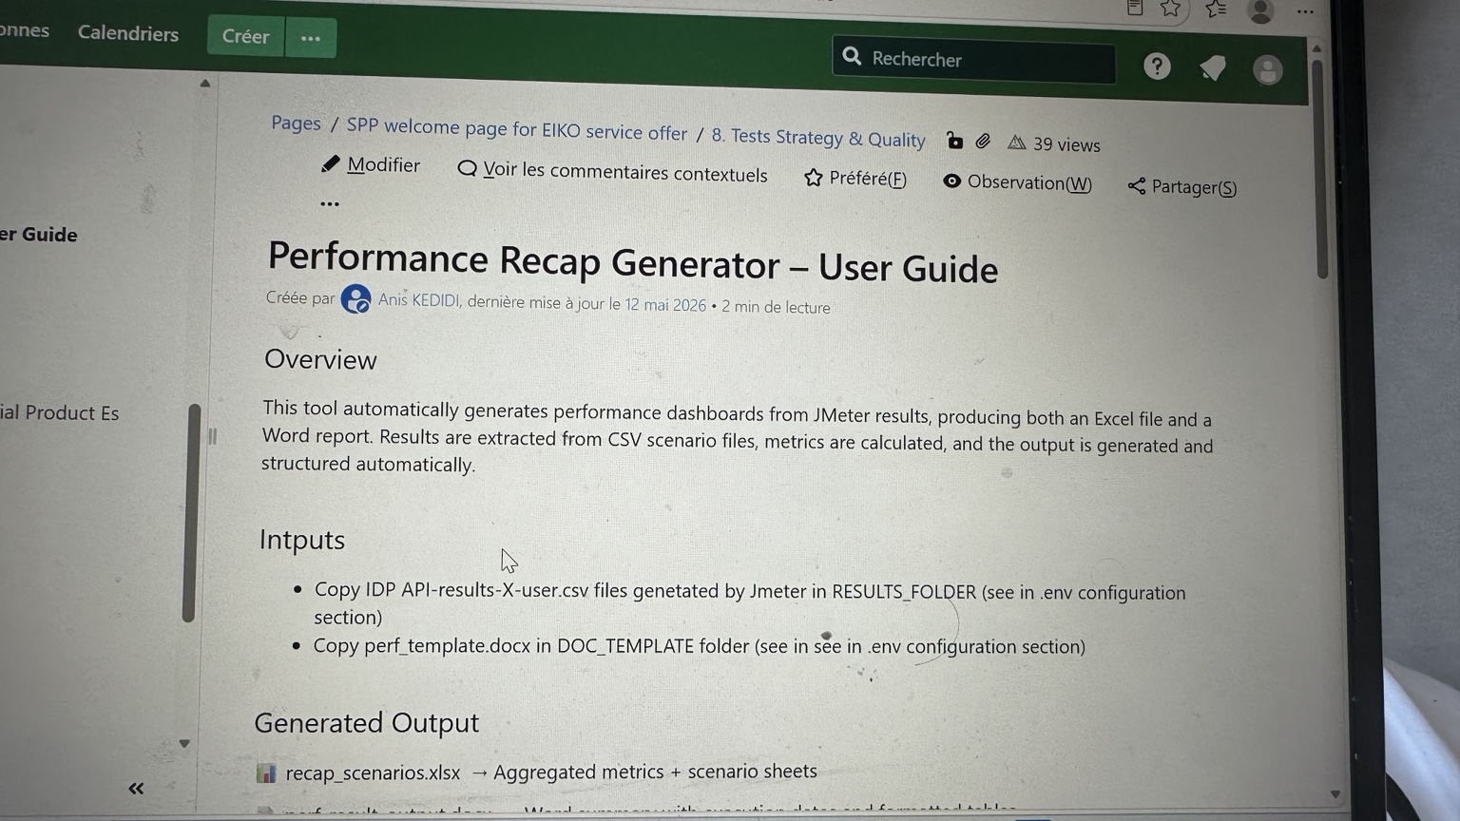
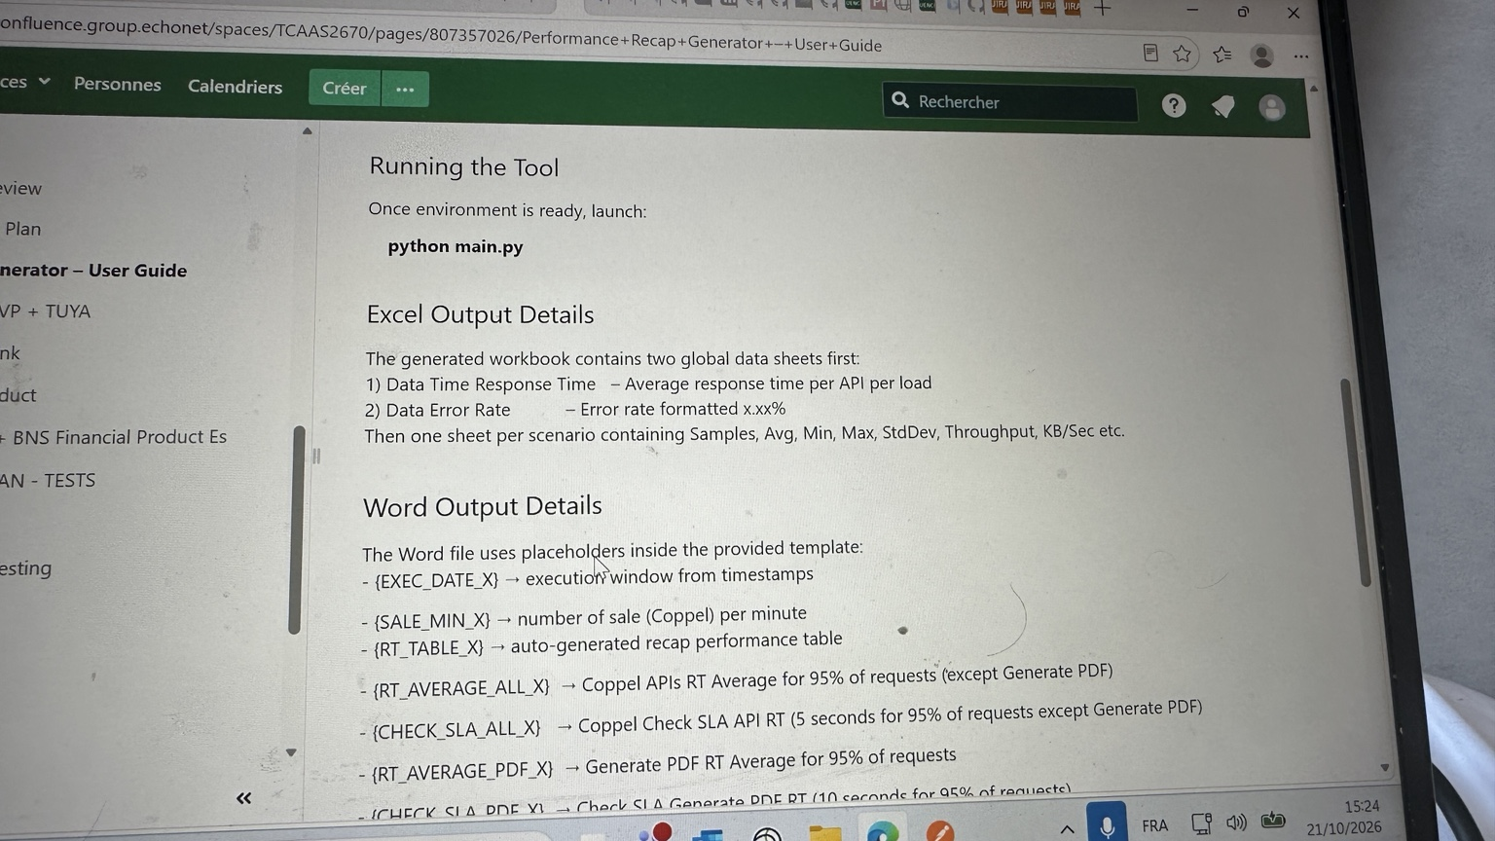
PART 1 / PERFORMANCE RECAP GENERATOR
07
Reference material available in Confluence
The screenshots below summarize the documentation currently available on Confluence.
What the documentation confirms
• The guide explains the purpose of the tool and the expected input files.
• It documents the generated Excel and Word outputs.
• It provides setup instructions and the launch command.
Attachments / artifacts to keep track of
• perfrecapgenerator.zip → source code bundle
• perf_template.docx → Word template used by the generator
• Confluence user guide → main operating reference for the tool
EIKO / HANDOVER

Slide 8
02
PART 2
Claims FPV2 reference architecture & flow follow-up
Clear, concise, and ready to hand over.
EIKO / HANDOVER

Slide 9
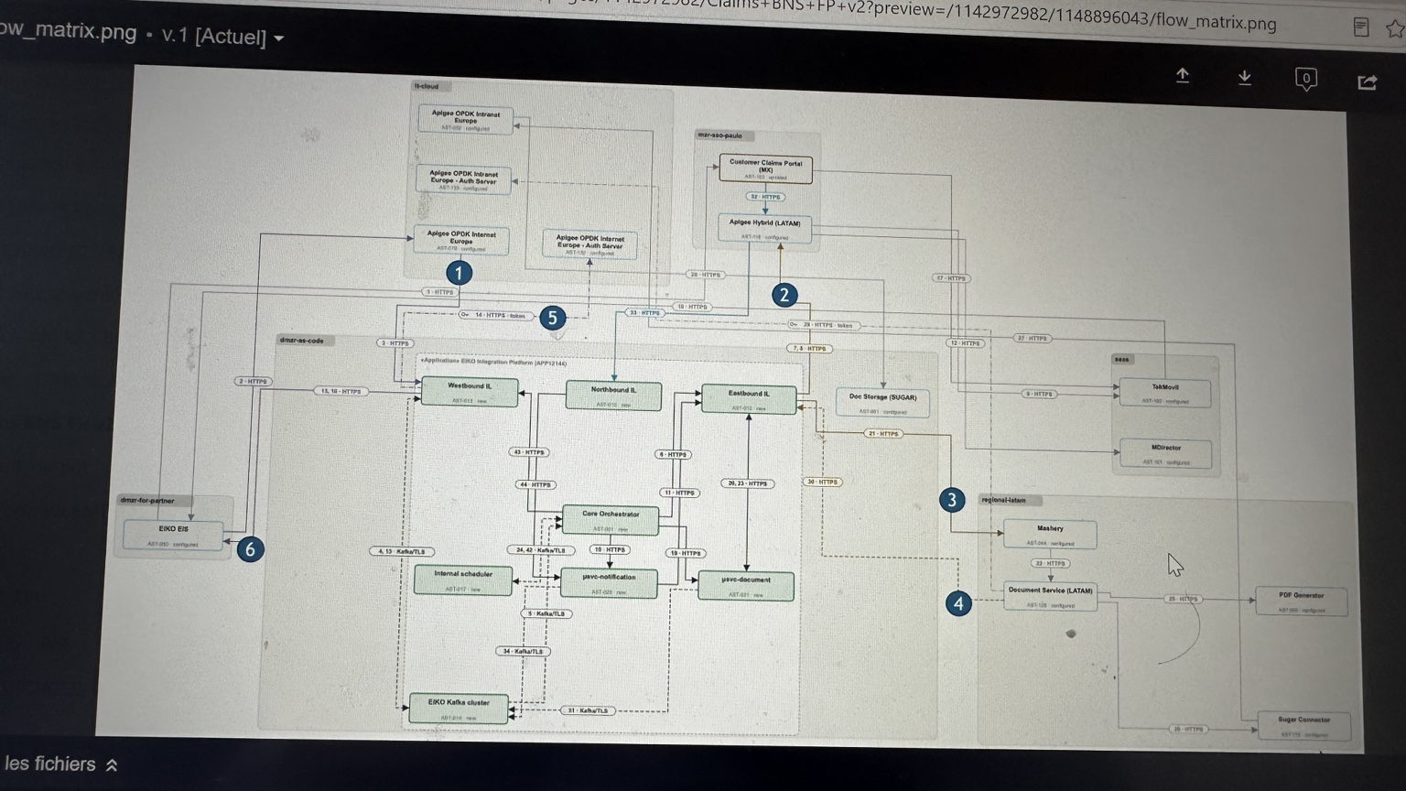
PART 2 / REFERENCE DIAGRAM
09
Claims FPV2 flow reference diagram
Temporary placeholder version — to be replaced later with a clearer source image.
EIKO / HANDOVER

Slide 10
PART 2 / FOLLOW-UP
10
How to use the Claims FPV2 material
Reference diagram
Operational matrix
Handover action
• Use the full-size diagram slide as the visual reference.
• The current image is a temporary placeholder and should be replaced when a clearer export is available.
• The diagram alone is not enough to know the real opening status of the flows.
• Keep the operational matrix as the source of truth for opened / in-progress / pending flows, tickets, and owners.
• Add the final link to the operational matrix.
• Replace the placeholder diagram with the updated image that you will provide later.
Overall handover message
• Part 1 explains how the JMeter campaign is executed and how test results are transformed into reporting deliverables. Part 2 provides the visual and operational references for Claims FPV2 follow-up.
EIKO / HANDOVER

